Slide 1
Computer Graphics Browser events
László Szécsi szecsi@iit.bme.hu
AIT

Slide 2
Editing code
we need
an index.html file creating a webpage with a canvas element
a CSS file for element positioning
JavaScript files for program logic
edit JavaScript with any text editor
Sublime Text Editor
SublimeLinter plugin JS support by installing SublimeLinter-jshint
JSFormat, GLSL, and SublimeCodeIntel packages provide syntax highlighting and automatic code formatting

Slide 3
Linter (jsHint)
checks your code in the editor and marks potential problems
helps you adhere to best practices and avoid some JS pitfalls
never use var
always use ===
always use {} after if
mark unknown (mistyped) identifiers
mark unused variables
settings in a file called .jshint
warnings may be expressly switched off locally in comments

Slide 4
HTML head

page fills window
<!DOCTYPE html>
<html>
<head>
<title>AIT Graphics 2020 spring</title>
<meta name="viewport"
content="width=device-width, initial-scale=1" />
<meta http-equiv="Content-Type"
content="text/html; charset=utf-8" />
<link rel="stylesheet" type="text/css"
href="css/style.css" />
</head>
element styles defined here
continued on next slide...

Slide 5
HTML body

this tag defines a section of the page
it is an HTML element
<body>
<div id="container">
<canvas id="canvas"></canvas>
<div id="overlay">Overlaid text.</div>
</div>
<script src="js/keynames.js"></script>
<script src="js/App.js"></script>
</body>
</html>
canvas for WebGL to draw on
We would like this HTML text drawn above the canvas.
Modifying the markup text from code,
it is easy to print formatted text.
JavaScript source code files

Slide 6
CSS #container

* {
margin: 0;
padding: 0;
}
#container {
position: absolute;
width: 100%;
height: 100%;
top: 0;
left: 0;
bottom: 0;
right: 0;
overflow: hidden;
}
fill page
no scrollbars please

Slide 7
CSS #canvas, #overlay

#overlay {
position: absolute;
left: 10px;
top: 10px;
z-index: 20;
}
#canvas {
background-image: url("bg.png");
position: absolute;
width: 100%;
height: 100%;
top: 0;
left: 0;
bottom: 0;
right: 0;
z-index: 10;
overflow: hidden;
}
be in the same place (overlaid)
text is on top of canvas
no scrollbars please

Slide 8
DOM
Document Object Model
hierarchy of HTML tags as elements in child-parent relationships
accessible as JS objects
root: document
only method we need right now:
getElementById

Slide 9
Access browser entities from JS: window and document
window
global object in JS
all global variables are properties of window
represents the view that displays the HTML document
> document.defaultView.document === document;
< true

Slide 10
JavaScript entry point?
actually, all scripts embedded in the HTML file are just executed sequentially
line by line, from the very beginning
this means class definitions are executed
not the method bodies, yet
after loading the page the actual work can start

Slide 11
Event listener for page load at the end of App.js

window.addEventListener('load', () => {
const canvas = document.getElementById("canvas");
const overlay = document.getElementById("overlay");
overlay.innerHTML = "<font color="red">Hello JavaScript!</font>";
const app = new App(canvas, overlay);
app.registerEventHandlers();
});
from this point on, this object is responsible for handling everything
we will implement this to make
sure the app knows when there
is some work to do

Slide 12
class App – constructor and canvas resolution

class App{
constructor(canvas, overlay) {
this.canvas = canvas;
this.overlay = overlay;
this.resize();
}
resize() {
this.canvas.width = this.canvas.clientWidth;
this.canvas.height = this.canvas.clientHeight;
}
set rendering resolution
we put this in a separate method called resize,
as we will need it again later, when the browser window size changes
rendering resolution
canvas size

Slide 13
class App – event handlers

registerEventHandlers() {
document.onkeydown = (event) => {
//jshint unused:false
};
document.onkeyup = (event) => {
//jshint unused:false
};
this.canvas.onmousedown = (event) => {
//jshint unused:false
};
this.canvas.onmousemove = (event) => {
//jshint unused:false
event.stopPropagation();
};
this.canvas.onmouseout = (event) => {
//jshint unused:false
};
this.canvas.onmouseup = (event) => {
//jshint unused:false
};
window.addEventListener('resize', () => this.resize() );
window.requestAnimationFrame( () => this.update() );
}
Closure: a pattern we will use a lot.
A locally defined function that has access to local variables of the defining context. With the arrow function syntax, this is the same as in the enclosing function.
single statement function body
needs no curly braces
empty parameter list
this method will be responsible for drawing a frame
trigger rendering

Slide 14
App registerEventHandlers

document.onkeydown = (event) => {
//jshint unused:false
};
document.onkeyup = (event) => {
//jshint unused:false
};
this.canvas.onmousedown = (event) => {
//jshint unused:false
};
this.canvas.onmousemove = (event) => {
//jshint unused:false
event.stopPropagation();
};
this.canvas.onmouseout = (event) => {
//jshint unused:false
};
this.canvas.onmouseup = (event) => {
//jshint unused:false };
};
user event handlers
to implement your own logic
single function parameter
empty function body (for now)

Slide 15
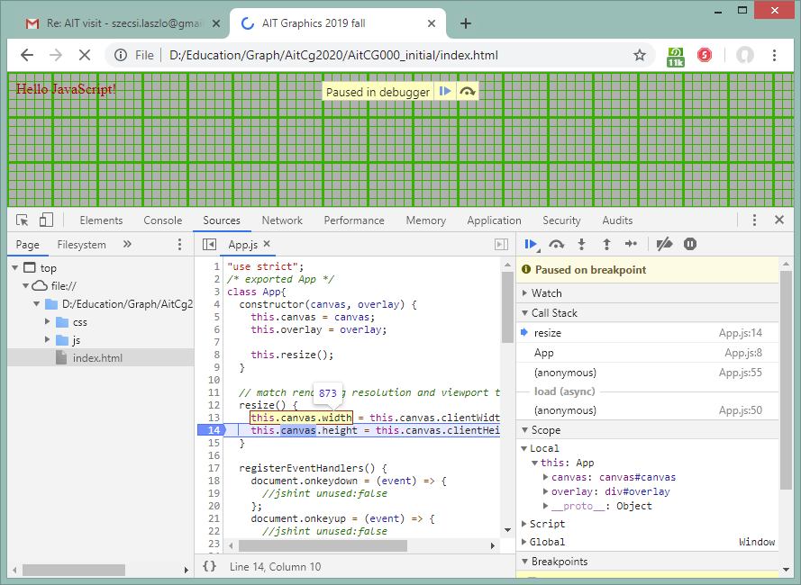
Launch in browser
!
step-by-step execution tools
Sources tab
Console tab
call stack
current
variable
values
breakpoint

Slide 16
Debugging in the browser
!
open the Sources tab of Debug Tools
find App.js
click a line number, in e.g. the resize method, placing a breakpoint
reload the webpage
execution should stop at the breakpoint
may continue or move line-by-line using buttons
hover mouse over variables to see their values, or check out Local
evaluate anything in the current context using the Console
see the chain of function calls and calling contexts with Call Stack

Slide 17
A typical debugging scenario
you read the error printed on the console, e.g.:
Cannot read property <properyName> of undefined.
click the error file/line indicator, taking you to the source file where the error happened
you place a breakpoint there
reload the webpage
when execution stops, you track back where the undefined value came from, quite possibly going down the call stack
you fix the error in your text editor

Slide 18
Move text to mouse click position
!
in constructor: add properties to App
textLeft, textBottom, initially zero
in the mouse down event handler, set the above properties according to the mouse click position
parameter event has properties x and y
in the update method, set the HTML content of the overlay to be some text positioned according to the properties
this.overlay.innerHTML =
`<div style=
"position:absolute;left:${this.textLeft}px;bottom:-${this.textBottom}px"> Hello AIT! </div>`;

Slide 19
Why defer to update?
innerHTML could be changed in the event handler directly
yet the previous slide advised to do it in update, setting it repeatedly
this does not provide any benefit now, other than confining HTML manipulation to the update method
this is analogous to how a new image will be rendered in every frame of an animation
changing the virtual world is not done by tampering with the image
instead, we change the description of the virtual world (now: textLeft, textBottom)
when an image needs to be rendered, we use the current virtual world data

Slide 20
Keep track of pressed keys
!
in constructor: add property to App
keysPressed, an object, initially empty (no properties)
in the key down/up event handler
parameter event has property keyCode
look up human-friendly key for keyCode name in global array keyNames
set the property with the above name in keysPressed to true/false
as the property name is obtained runtime, you need to use the [] syntax
in the update method, display the contents of keysPressed
this.overlay.innerHTML =
`<div style=
"position:absolute;left:${this.textLeft}px;bottom:-${this.textBottom}px"> ${JSON.stringify(this.keysPressed)} </div>`;

Slide 21
Increase and decrease font size on keys 'T' and 'G'
!
introduce new property for font size
increase or decrease value in every frame, depending on keysPressed.T and keysPressed.G
use a font tag in the innerHTML, with the size parameter set from the property value

